Slide 1
Verifying remote executions: from wild implausibility to near practicality
Michael Walfish
NYU and UT Austin

Slide 2
Acknowledgment
Andrew J. Blumberg (UT), Benjamin Braun (UT), Ariel Feldman (UPenn), Richard McPherson (UT), Nikhil Panpalia (Amazon), Bryan Parno (MSR), Zuocheng Ren (UT), Srinath Setty (UT), and Victor Vu (UT).

Slide 3
Problem statement: verifiable computation
“f”, x
client
server
y, aux.
check whether y = f(x), without computing f(x)
The motivation is 3rd party computing: cloud, volunteers, etc.
We want this to be:
1. Unconditional, meaning no assumptions about the server
2. General-purpose, meaning arbitrary f
3. Practical, or at least conceivably practical soon

Slide 4
Theory can help. Consider the theory of Probabilistically Checkable Proofs (PCPs).
[almss92, as92]
“f”, x
client
server
y’
y
...
reject
...
accept
But the constants are outrageous
Under naive PCP implementation, verifying multiplication of 500×500 matrices would cost 500+ trillion CPU-years
This does not save work for the client
Notes:
1.6*10^22 seconds = 5 * 10^14 years = 500 trillion

Slide 5
We have refined several strands of theory.
We have reduced the costs of a PCP-based argument system [iko ccc07] by 20 orders of magnitude.
hotos11
ndss12
security12
eurosys13
oakland13
sosp13
We have implemented the refinements.
This research area is thriving.
cmt itcs12
trmp hotcloud12
bcgt itcs13
ggpr eurosys13
pghr oakland13
Thaler crypto13
bcgtv crypto13
….
We predict that PCP-based machinery will be a key tool for building secure systems.
Notes:
1.6*10^22 seconds = 5 * 10^14 years = 500 trillion

Slide 6
Zaatar: a PCP-based efficient argument
[ndss12, security12, eurosys12]
(2) Pantry: extending verifiability to stateful computations
[sosp13]
(3) Landscape and outlook

Slide 7
Zaatar incorporates PCPs but not like this:
“f”, x
client
server
y
...
accept/reject
...
The proof is not drawn to scale: it is far too long to be transferred.
Even the asymptotically short PCPs seem to have high constants.
[bghsv ccc05, bghsv sijc06, Dinur jacm07, Ben-Sasson & Sudan sijc08]
We move out of the PCP setting: we make computational assumptions. (And we allow # of query bits to be superconstant.)

Slide 8
Instead of transferring the PCP …
client
server
...
… Zaatar uses an efficient argument [Kilian crypto92,95]:
commit request
client
server
commit response
queries
PCPQuery(q){
return <q,w>;
}
q₁, q₂, q₃, …
...
efficient checks
[iko ccc07]
q₁•w q₂•w q₃•w
[almss92]
accept/reject

Slide 9
The server’s vector w encodes an execution trace of f(x).
[almss92]
NOT
AND
1
0
x₀
0
y₀
1
w
OR
0
NOT
1
f ( )
x₁
1
x
1
y₁
0
0
AND
1
NOT
…
0
x_{n}
0
0
1
1
What is in w?
An entry for each wire; and
An entry for the product of each pair of wires.

Slide 10
Zaatar uses an efficient argument [Kilian crypto92,95]:
commit request
client
server
commit response
queries
PCPQuery(q){
return <q,w>;
}
q₁, q₂, q₃, …
...
efficient checks
[iko ccc07]
q₁•w q₂•w q₃•w
[almss92]
accept/reject
This is still too costly (by a factor of 10²³), but it is promising.

Slide 11
Zaatar incorporates refinements to [iko ccc07], with proof.
client
server
“f”
, x
y
commit request
commit response
w
queries
query vectors: q₁, q₂, q₃, …
checks
response scalars: q₁•w, q₂•w, …
accept/reject

Slide 12
The client amortizes its overhead by reusing queries over multiple runs. Each run has the same f but different input x.
query vectors: q₁, q₂, q₃, …
client
server
w⁽¹⁾
w⁽²⁾
w⁽³⁾

Slide 13
client
server
“f”
, x^{(j)}
y^{(j)}
commit request
commit response
w^{(j)}
✔
queries
query vectors: q₁, q₂, q₃, …
checks
response scalars: q₁•w^{(j)}, q₂•w^{(j)}, …
accept/reject

Slide 14
Boolean circuit
Arithmetic circuit
Arithmetic circuit with concise gates
something gross
×
+
a•b
×
•
a•b
+
a•b
×
+
×
Unfortunately, this computational model does not really handle fractions, comparisons, logical operations, etc.

Slide 15
Programs compile to constraints over a finite field (F_{p}).
dec-by-three.c
f(X) {
Y = X − 3;
return Y;
}
compiler
0 = Z − X,
0 = Z – 3 – Y
Input/output pair correct ⟺ constraints satisfiable.
As an example, suppose X = 7.
if Y = 4 …
if Y = 5 …
0 = Z – 7
0 = Z – 3 – 4
0 = Z – 7
0 = Z – 3 – 5
… there is a solution
… there is no solution

Slide 16
How concise are constraints?
0 = (Z₁ – Z₂ ) • M – Z₃,
0 = (1 – Z₃) • (Z₁ – Z₂ )
Z₃ ← (Z₁ != Z₂)
“Z₁ < Z₂”
log |F_{p}| constraints
loops
unrolled
Our compiler is derived from Fairplay [mnps security04]; it turns the program into list of assignments (SSA).
We replaced the back-end (now it is constraints), and later the front-end (now it is C, inspired by [Parno et al. oakland13]).

Slide 17
if (X₁ < X₂)
Y ← 3
else
Y ← 4
M • {C<},
0 = M • (Y – 3),
(1 – M) • {C≥},
0 = (1 – M) • (Y – 4)
Recall that the constraints are over F_{p}.
C< is satisfiable iff X₁ − X₂ is in the “negative” range [p − 2^{N–1}, p).
0 = B₀ (1 – B₀),
0 = B₁ (2 – B₁),
…,
0 = B_{N–2} • (2^{N–2} – B_{N–2}),
X₁ – X₂ = (p – 2^{N–1}) + (B₀+…+B_{N–2})
C< =

Slide 18
program excerpt
constraints
Z₁ ← Z₂
0 = Z₁ – Z₂
Z₁ ← Z₂ + Z₃•Z₄
0 = Z₁ – Z₂ – Z₃•Z₄
Y ← X₁ nand X₂
0 = 1 – X₁•X₂ – Y
Y ← X₁ or X₂
0 = (1 – X₁)•(X₂ – 1) + 1 – Y
Y ← (X₁ != X₂)
0 = (X₁ – X₂ ) • M – Y,
0 = (1 – Y) • (X₁ – X₂ )

Slide 19
The proof vector now encodes the assignment that satisfies the constraints.
1
1
w
1 = (Z₁ – Z₂ ) • M
0 = Z₃ − Z₄
0 = Z₃Z₅ + Z₆ − 5
219
w
0
0
0
2047
0
1
1
1
1013
0
0
1
0
1
1
0
Z₁=23, Z₂=187, …,
805
1
187
0
23
The savings from the change are enormous.

Slide 20
client
server
✔
“f”, x^{(j)}
y^{(j)}
commit request
commit response
w^{(j)}
✔
queries
query vectors: q₁, q₂, q₃, …
checks
response scalars: q₁•w^{(j)}, q₂•w^{(j)}, …
accept/reject

Slide 21
We (mostly) eliminate the server’s PCP-based overhead.
server
w
after: # of entries linear in computation size
before: # of entries quadratic in computation size
The client and server reap tremendous benefit from this change.
Now, the server’s overhead is mainly in the cryptographic machinery and the constraint model itself.

Slide 22
client
server
commit request
w
commit response
PCP verifier
w
q₁, q₂, …, q_{u}
queries
π(q₁), …, π(q_{u})
responses
(z, h)
linearity test
quad corr. test
circuit test
|w|=|Z|²
(z, z ⊗ z)
π(•)=<•,w>
|w|=|Z|+|C|
[ggpr Eurocrypt 2013]
new quad.test
Any computation has a linear PCP whose proof vector is (quasi)linear in the computation size. (Also shown by [bciop tcc13].)
This resolves a conjecture of Ishai et al. [IKO CCC07]

Slide 23
client
server
✔
“f”, x^{(j)}
y^{(j)}
commit request
commit response
w^{(j)}
✔
queries
query vectors: q₁, q₂, q₃, …
✔
✔
checks
response scalars: q₁•w^{(j)}, q₂•w^{(j)}, …
accept/reject

Slide 24
We strengthen the linear commitment primitive of [IKO CCC07].
client
server
Enc(r_{i})
?
PCP verifier
Enc(π(r_{i}))
π(•)
q₁, q₂, …, q_{u}
(q_{i}, t_{i})
π(q₁), …, π(q_{u})
(π(q_{i}), π(t_{i}))
PCP tests
Enc(r)
Enc(π(r))
?
t_{i} = r_{i} + α_{i}•q_{i}
π(t_{i}) = π(r_{i}) + α_{i}•π (q_{i})
(q₁, …, q_{u}, t)
t = r + α₁•q₁ + … + α_{u}•q_{u}
(π(q₁), …, π(q_{u}), π(t))
?
π(t) = π(r) + α₁•π (q₁) + … + α_{u}•π (q_{u})
This saves orders of magnitude in cryptographic costs.

Slide 25
client
server
✔
“f”, x^{(j)}
y^{(j)}
✔
commit request
commit response
w^{(j)}
✔
queries
query vectors: q₁, q₂, q₃, …
✔
✔
checks
response scalars: q₁•w^{(j)}, q₂•w^{(j)}, …
accept/reject

Slide 26
Our implementation of the server is massively parallel; it is threaded, distributed, and accelerated with GPUs.
Some details of our evaluation platform:
It uses a cluster at Texas Advanced Computing Center (tacc)
Each machine runs Linux on an Intel Xeon 2.53 GHz with 48gb of ram.

Slide 27
Amortized costs for multiplication of 256×256 matrices:
 | Under the theory, naively applied | Under Zaatar
client CPU time | >100 trillion years | 1.2 seconds
server CPU time | >100 trillion years | 1 hour
However, this assumes a (fairly large) batch.

Slide 28
What are the cross-over points?
What is the server’s overhead versus native execution?
At the cross-over points, what is the server’s latency?

Slide 29
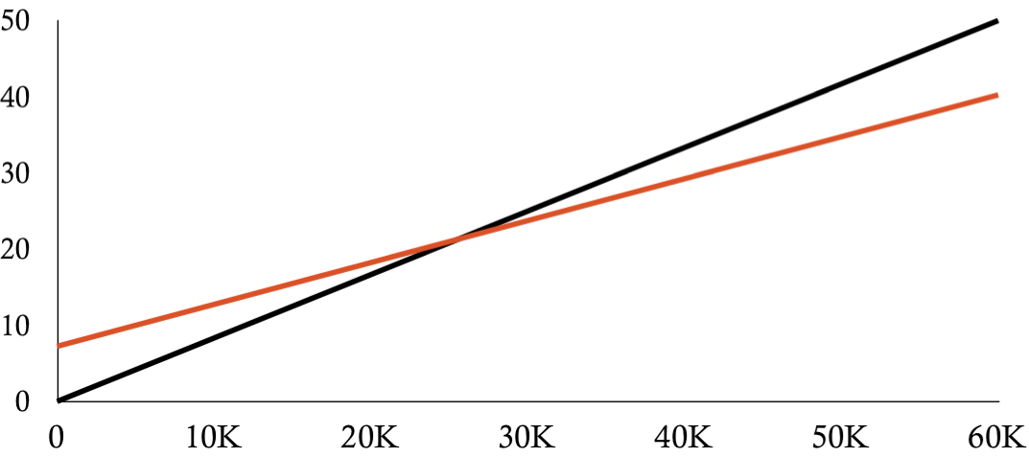
The cross-over point is high but not totally ridiculous.
verification cost
(minutes of CPU time)
Zaatar (slope: 33 ms/inst)
native (slope: 50 ms/inst)
instances of 150 x 150 matrix multiplication

Slide 30
The server’s costs are unfortunately very high.

Slide 31
(1) If verification work is performed on a CPU
mat. mult.
(m=150)
Floyd-Warshall
(m=25)
root finding
(m=256, L=8)
PAM clustering
(m=20, d=128)
cross-over | 25,000 inst. | 43,000 inst. | 210 inst. | 22,000 inst.
client CPU | 21 mins. | 5.9 mins. | 2.7 mins. | 4.5 mins.
server CPU | 12 months | 8.9 months | 22 hours | 4.2 months
(2) If we had free crypto hardware for verification …
cross-over | 4,900 inst. | 8,000 inst. | 40 inst. | 5,000 inst.
client CPU | 4 mins. | 1.1 mins. | 31 secs. | 61 secs.
server CPU | 2 months | 1.7 months | 4.2 hours | 29 days

Slide 32
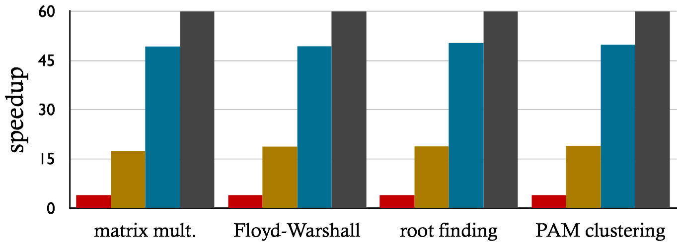
Parallelizing the server results in near-linear speedup.
60 cores
60 cores (ideal)
20 cores
4 cores
matrix mult.
(m=150)
Floyd-Warshall
(m=25)
root finding
(m=256, L=8)
PAM clustering
(m=20, d=128)

Slide 33
Zaatar is encouraging, but it has limitations:
The server’s burden is too high, still.
The client requires batching to break even.
The computational model is stateless (and does not allow external inputs or outputs!).

Slide 34
Zaatar: a PCP-based efficient argument
[ndss12, security12, eurosys12]
(2) Pantry: extending verifiability to stateful computations
[sosp13]
(3) Landscape and outlook

Slide 35
Pantry creates verifiability for real-world computations
before:
after:
query, digest
C
S
DB
F, x
result
C
S
y
C supplies all inputs
F is pure (no side effects)
All outputs are shipped back
F, x
C
S
RAM
y
map(), reduce(), input filenames
C
S_{i}
output filenames

Slide 36
client
server
“f”
, x^{(j)}
“f”
y^{(j)}
“f”
commit request
commit response
w^{(j)}
query vectors: q₁, q₂, q₃, …
checks
response scalars: q₁•w^{(j)}, q₂•w^{(j)}, …
accept/reject

Slide 37
The compiler pipeline decomposes into two phases.
GGPR encoding
0 = X + Z₁
0 = Y + Z₂
0 = Z₁Z₃ − Z₂
….
client
F(){
[subset of C]
}
arith. circuit
server
constraints (E)
“If E(X=x,Y=y) is satisfiable, computation is done right.”
=
“E(X=x,Y=y) has a
satisfying assignment”
F, x
client
y
server
Design question: what can we put in the constraints so that satisfiability implies correct storage interaction?

Slide 38
How can we represent storage operations?
Representing “load(addr)” explicitly would be horrifically expensive.
Straw man: variables M₀, …, M_{size} contain state of memory.
B = M₀ + (A − 0) • F₀
B = M₁ + (A − 1) • F₁
B = M₂ + (A − 2) • F₂
…
B = M_{size} + (A − size) • F_{size}
B = load(A)
Requires two variables for every possible memory address!

Slide 39
How can we represent storage operations? (2)
Consider content hash blocks:
digest
?
cli.
serv.
hash(block) = digest
block
They bind references to values
They provide a substrate for verifiable RAM, file systems, …
[Merkle crypto87, Fu et al. osdi00, Mazières & Shasha podc02, Li et al. osdi04]
Key idea: encode the hash checks in constraints
This can be done (reasonably) efficiently
Folklore: “this should be doable.” (Pantry’s contribution: “it is.”)

Slide 40
We augment the subset of C with the semantics of untrusted storage
block = vget(digest): retrieves block that must hash to digest
hash(block) = vput(block): stores block; names it with its hash
add_indirect(digest d, value x) {
value z = vget(d);
y = z + x;
return y;
}
d = hash(Z)
y = Z + x
Server is obliged to supply the “correct” Z (meaning something that hashes to d).

Slide 41
Putting the pieces together
C with RAM,
search trees
[Merkle 87]
subset of C
+
{vput, vget}
QAP
cli
circuit
serv
map(), reduce()
constraints (E)
F, x
client
y
server
recall:
“I know a satisfying assignment to E(X=x,Y=y)”
=
checks-of-hashes pass ⟺ satisfying assignment identified
checks-of-hashes pass ⟺ storage interaction is correct
storage abstractions can be built from {vput(), vget()}

Slide 42
How can we represent storage operations?
Srinath will tell you how.
(Hint: consider content hash blocks: blocks named by a cryptographic hash, or digest, of their contents.)

Slide 43
The client is assured that a MapReduce job was performed correctly—without ever touching the data.
map(), reduce(), in_digests
client
out_digests
M_{i}
R_{i}
The two phases are handled separately:
mappers
reducers
…
…
in = vget(in_digest);
out = map(in);
for r=1,…,R:
d[r] = vput(out[r])
for m=1,…,M:
in[m] = vget(e[m]);
out = reduce(in);
out_digest = vput(out);
in_digests
…
…
…

Slide 44
The client is assured that a MapReduce job was performed correctly—without ever touching the data.
map(), reduce(), in_digests
client
out_digests
M_{i}
R_{i}
The two phases are handled separately:
mappers
reducers
…
…
in_digests
…
…
…

Slide 45
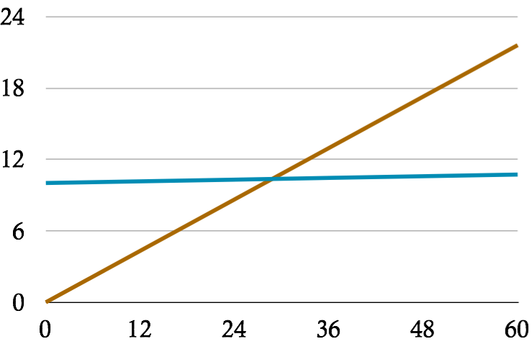
Example: for a DNA subsequence search, the client saves work, relative to performing the computation locally.
baseline
CPU time (minutes)
Pantry
number of nucleotides in the input dataset (billions)
A mapper gets 600k nucleotides and outputs matching locations
One reducer per 10 mappers
The graph is an extrapolation
Notes:
baseline: 13ms. 600k is the chunk size. 4 is the substring size. 10 mappers per reducer
200 work units = 2000 mappers
run up to 1.2 billion; extrapolate the rest

Slide 46
Pantry applies fairly widely
Our implemented applications include:
query, digest
client
server
DB
result
Verifiable queries in (highly restricted) subset of SQL
Privacy-preserving facial recognition
Our implementation works with Zaatar and Pinocchio [Parno et al. oakland13]

Slide 47
Zaatar: a PCP-based efficient argument
[ndss12, security12, eurosys12]
(2) Pantry: extending verifiability to stateful computations
[sosp13]
(3) Landscape and outlook

Slide 48
We describe the landscape in terms of our three goals.
Gives up being unconditional or general-purpose:
Replication [Castro & Liskov TOCS02], trusted hardware [Chiesa & Tromer ICS10, Sadeghi et al. TRUST10], auditing [Haeberlen et al. SOSP07, Monrose et al. NDSS99]
Special-purpose [Freivalds MFCS79, Golle & Mironov RSA01, Sion VLDB05, Michalakis et al. NSDI 07, Benabbas et al. CRYPTO11, Boneh & Freeman EUROCRYPT11]
Unconditional and general-purpose but not geared toward practice:
Use fully homomorphic encryption [Gennaro et al., Chung et al. CRYPTO10]
Proof-based verifiable computation [GMR85, Ben-Or et al. STOC88, BFLS91, Kilian STOC92, ALMSS92, AS92, GKR STOC08, Ben-Sasson et al. STOC13, Bitansky et al. STOC13, Bitanksy et al. ITCS12]

Slide 49
Experimental results are now available from four projects.
Pepper, Ginger, Zaatar, Allspice, Pantry
hotos11
ndss12
security12
eurosys13
oakland13
sosp13
CMT, Thaler
cmt itcs12
Thaler et al. hotcloud12
Thaler crypto13
Pinocchio
ggpr eurocrypt13
Parno et al. oakland13
BCGTV
bcgtv crypto13
bcgt itcs13
bciop tcc13

Slide 50
A key trade-off is performance versus expressiveness.
 |  |  | applicable computations
 | setup costs |  | “regular” | straightline | pure, no RAM | stateful, RAM | general loops
none (fast prover) |  |  | Thaler [crypto13]
none |  |  | CMT, TRMP [itcs,Hotcloud12]
low |  |  |  | Allspice [Oakland13]
medium |  |  | Pepper [ndss12] | Ginger [Security12] | Zaatar [Eurosys13] | Pantry [sosp13]
high |  |  |  |  | Pinocchio [Oakland13] | Pantry [sosp13]
very high |  |  |  |  |  | BCGTV [crypto13] | BCGTV [crypto13]
better
lower cost,
less crypto
more expressive
better crypto properties:
ZK, non-interactive, etc.

Slide 51
Quick performance comparison
Data are from our re-implementations and match or exceed published results.
All experiments are run on the same machines (2.7Ghz, 32GB RAM). Average 3 runs (experimental variation is minor).
Benchmarks: 150×150 matrix multiplication and clustering algorithm

Slide 52
The cross-over points can sometimes improve, at the cost of expressiveness.

Slide 53
The server’s costs are high across the board.
10¹¹

Slide 54
Summary of performance in this area
None of the systems is at true practicality
Server’s costs still a disaster (though lots of progress)
Client approaches practicality, at the cost of generality
Otherwise, there are setup costs that must be amortized
(We focused on CPU; network costs are similar.)

Slide 55
Research questions:
Can we design more efficient constraints or circuits?
Can we apply cryptographic and complexity-theoretic machinery that does not require a setup cost?
Can we provide comprehensive secrecy guarantees?
Can we extend the machinery to handle multi-user databases (and a system of real scale)?

Slide 56
Summary and take-aways
We have reduced the costs of a PCP-based argument system [Ishai et al., CCC07] by 20 orders of magnitude
We broaden the computational model, handle stateful computations (MapReduce, etc.), and include a compiler
There is a lot of exciting activity in this research area
This is a great research opportunity:
There are still lots of problems (prover overhead, setup costs, the computational model)
The potential is large, and goes far beyond cloud computing

Slide 57
Appendix Slides

Slide 58
PERFORMANCE COMPARISON

Slide 59
Experimental setup and ground rules
A system is included iff it has published experimental results.
Data are from our re-implementations and match or exceed published results.
All experiments are run on the same machines (2.7Ghz, 32GB RAM). Average 3 runs (experimental variation is minor).
For a few systems, we extrapolate from detailed microbenchmarks
Measured systems:
General-purpose: IKO, Pepper, Ginger, Zaatar, Pinocchio
Special-purpose: CMT, Pepper-tailored, Ginger-tailored, Allspice
Benchmarks: 150×150 matrix multiplication and clustering algorithm (others in our papers)

Slide 60
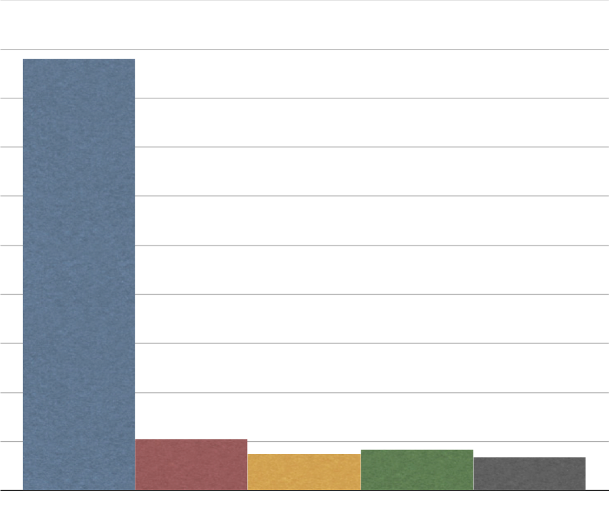
Verification cost sometimes beats (unoptimized) native execution.
10²⁶
Ishai et al. (PCP-based efficient argument)
10²³
10²⁰
10¹⁷
150×150 matrix multiplication
verification cost
(ms of CPU time)
10¹⁴
10¹¹
10⁸
50 ms
10⁵
Pepper
Ginger
Zaatar
Pinocchio
10²
0
5 ms

Slide 61
Some of the general-purpose protocols have reasonable cross-over points.
1.6 days
instances of 150x150 matrix multiplication

Slide 62
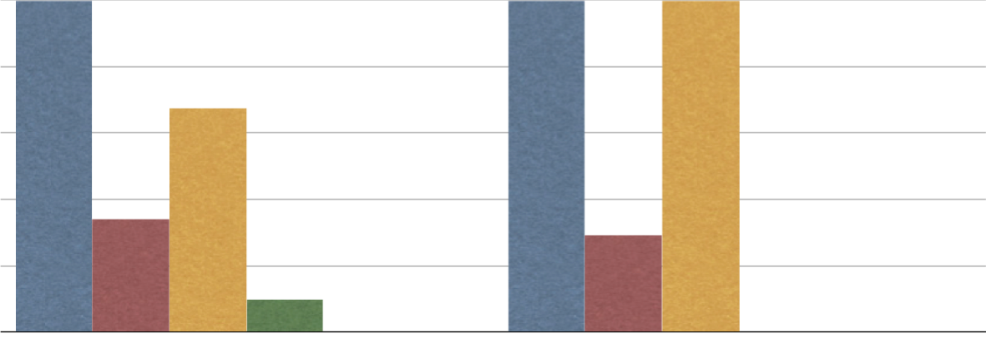
The cross-over points can sometimes improve with special-purpose protocols.
4.5M
1.2B
450K
60K
50.5K
45K
cross-over point
30K
25.5K
22K
15K
7.4K
N/A
7
1
Ginger
Zaatar
Allspice
CMT
Ginger
Zaatar
Allspice
CMT
Pinocchio
Pinocchio
Ginger-tailored
Ginger-tailored
matrix multiplication (m=150)
PAM clustering (m=20, d=128)

Slide 63
When Allspice is applicable, it has low cross-over points.
mat. mult.
(m=128)
poly. eval
(m=512)
root finding
(m=256, L=8)
Zaatar | 4400 | 180 | 210
Allspice | 47 | 7 | 15
But, of our benchmarks, CMT-improved does not apply to:
PAM clustering
Longest common subsequence
Floyd-Warshall

Slide 64
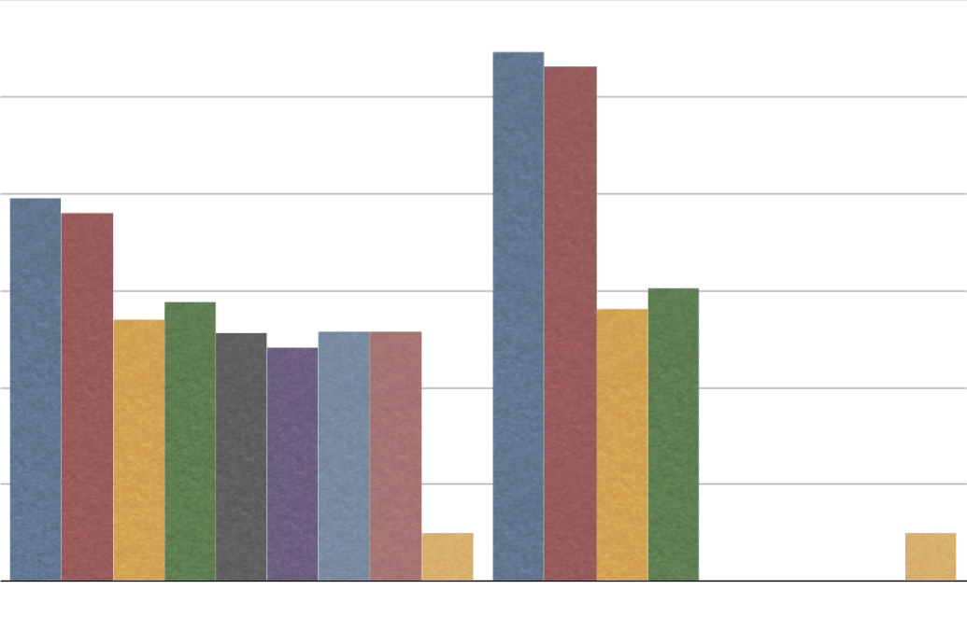
The server’s costs are pretty much preposterous.
10¹¹
10⁹
10⁷
10⁵
server’s cost
normalized to native C
10³
10¹
N/A
0
Pepper
Ginger
Zaatar
CMT
Pepper
Ginger
Zaatar
CMT
Allspice
Allspice
Pinocchio
native C
Pinocchio
native C
Pepper-tailored
Ginger-tailored
Pepper-tailored
Ginger-tailored
matrix multiplication (m=150)
PAM clustering (m=20, d=128)

Slide 65
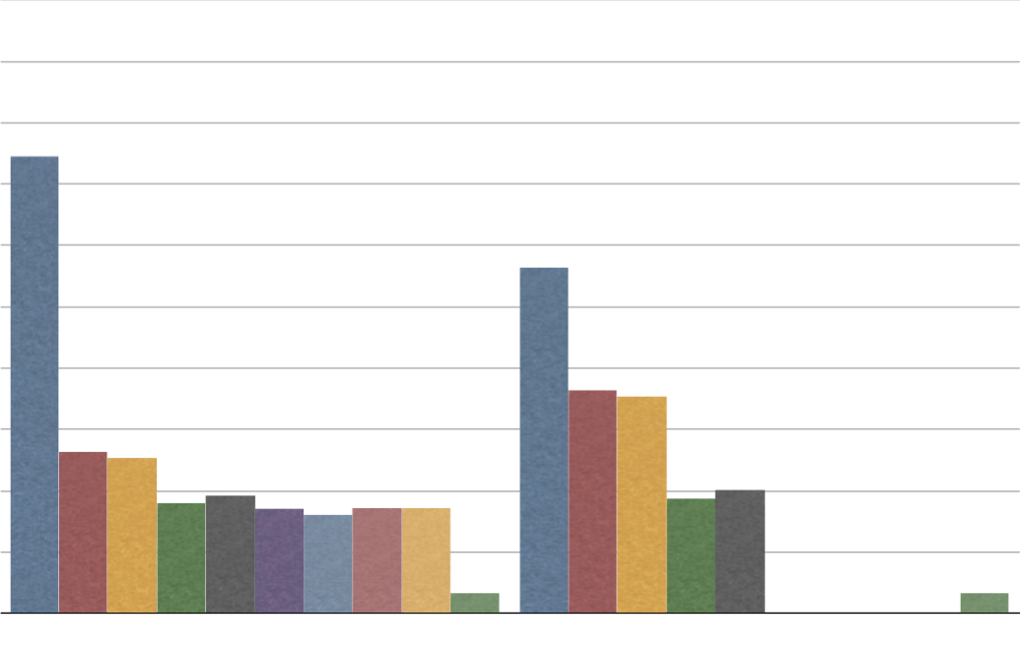
The server’s costs are pretty much preposterous.
10²³
10²⁰
10¹⁷
10¹⁴
server’s cost
normalized to native C
10¹¹
10⁸
10⁵
N/A
10²
0
IKO
Zaatar
CMT
IKO
CMT
Ginger
Pepper
Pepper
Ginger
Allspice
Zaatar
Allspice
Pinocchio
native C
Pinocchio
native C
Pepper-tailored
Pepper-tailored
Ginger-tailored
Ginger-tailored
matrix multiplication (m=150)
PAM clustering (m=20, d=128)

